Slide 1

Quiz management system
CSCE 5350: Fundamentals of Database System
Instructor: Dr. Nirosha Dinayadura
Team 13:
Kishan Kumar Zalavadia
Uday Bhaskar Valapadasu
Saptagiri Naik Bhukya
11685261
11696364
11699072

Slide 2

index
Objective
Introduction
App Entities
ER Diagram
Technologies Used
Database Schemes
Challenges
Application Walkthrough
Conclusion
Project GitHub Link:
https://github.com/Kishan-Kumar-Zalavadia/FDB_Quiz_Management_System

Slide 3

Objective
Our main objective in developing this project is to gain a deep understanding of database schema structures and apply this knowledge to create a real-time quiz management system application. By designing and implementing an interconnected Entity-Relationship (ER) diagram within the system's database, we aim to address practical challenges in educational assessments. This hands-on experience will enhance our comprehension of how databases manage complex relationships and transactions in an actual application environment, while also providing a user-friendly platform for both educators and students to conduct and participate in quizzes seamlessly.

Slide 4

Introduction
The quiz management system is designed to improve the assessment process. This system is easy to use and has benefits like tracking the quiz history. Professors can easily conduct quizzes with multiple attempts. And the students can take quizzes conveniently. This system’s database consists of 17 tables which are interconnected. Our system gives a very convenient UI which makes it attractive to use.

Slide 5
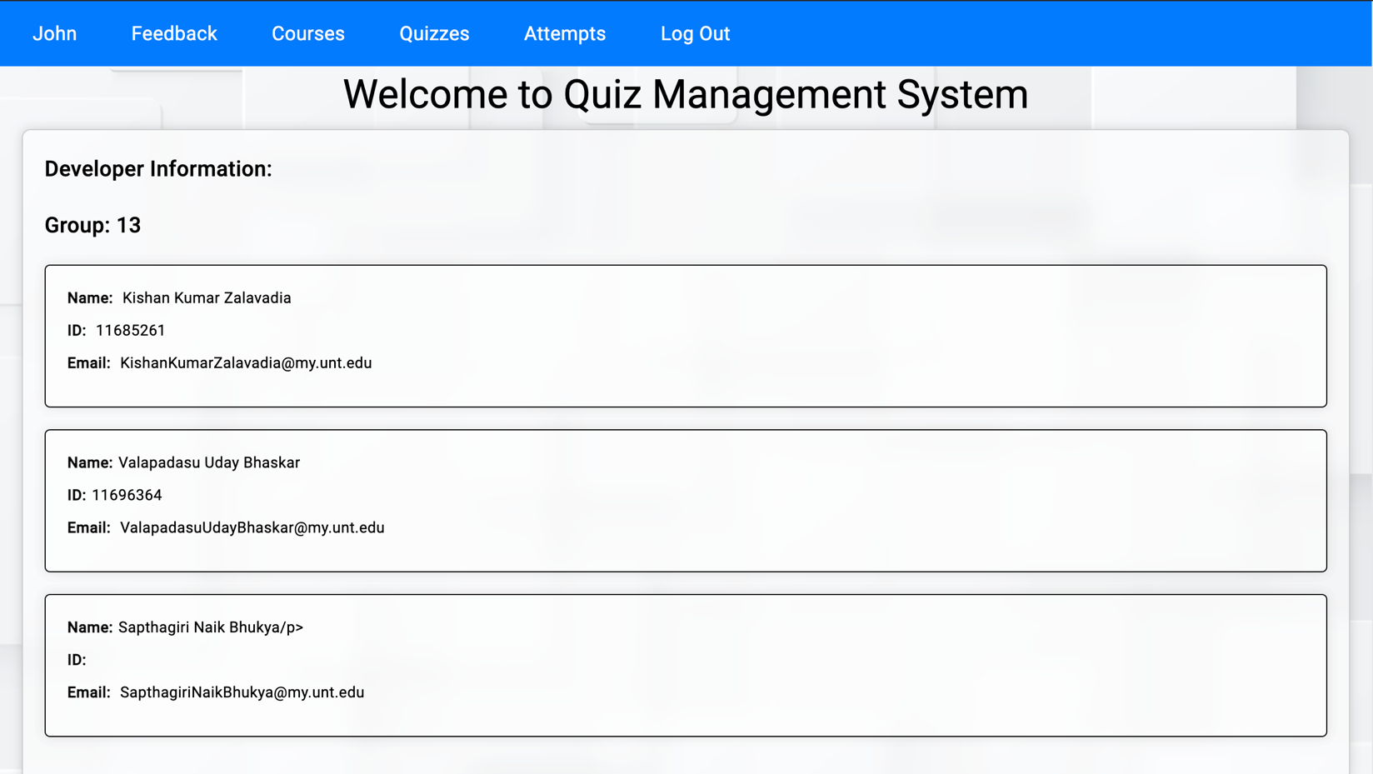

App entities
Announcement
User
Profile
Role
Feedback
Department
Course
User_Course
Department_Course
Quiz
Quiz_Feedback
Question
Option
Media
Attempts
Quiz_Attempt_Option
Result

Slide 6
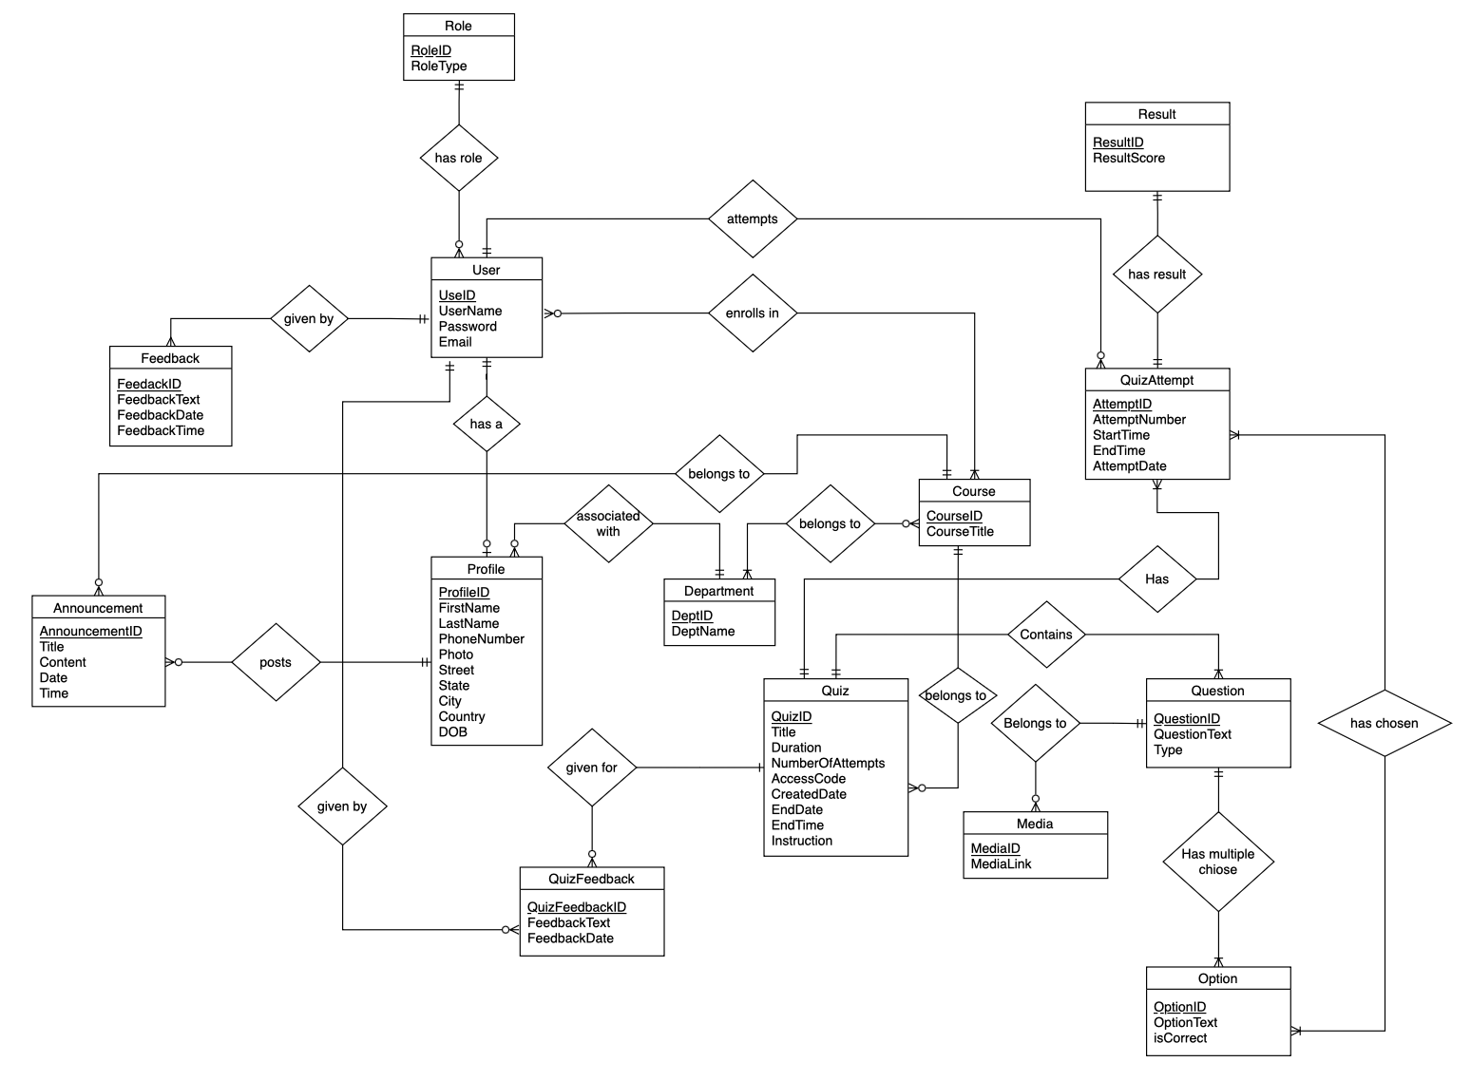

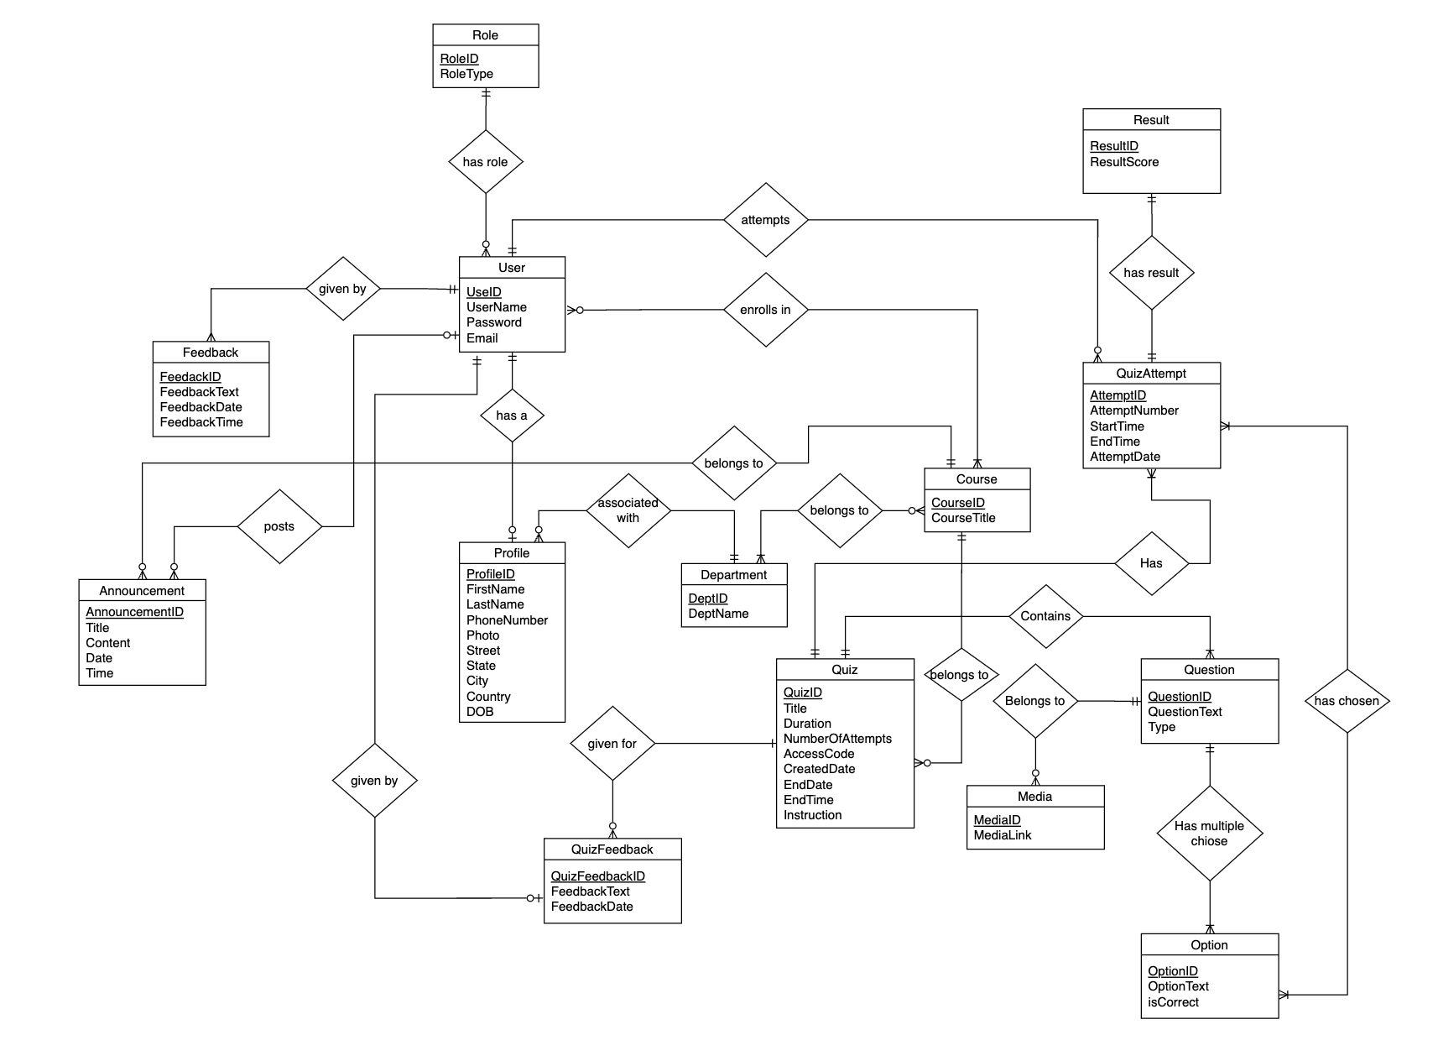
ER Diagram

Slide 7

Technologies
Frontend: Angular, HTML, SCSS, TypeScript
Backend: Spring Boot, Java
Database: MySQL
API Testing: Postman
Version Control / Project Management: Git/GitHub

Slide 8
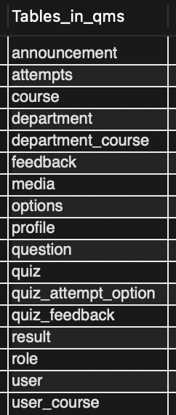
Database schemas

Slide 9
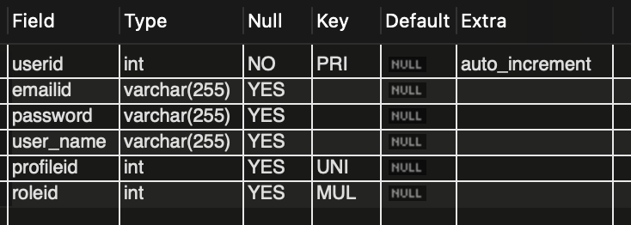
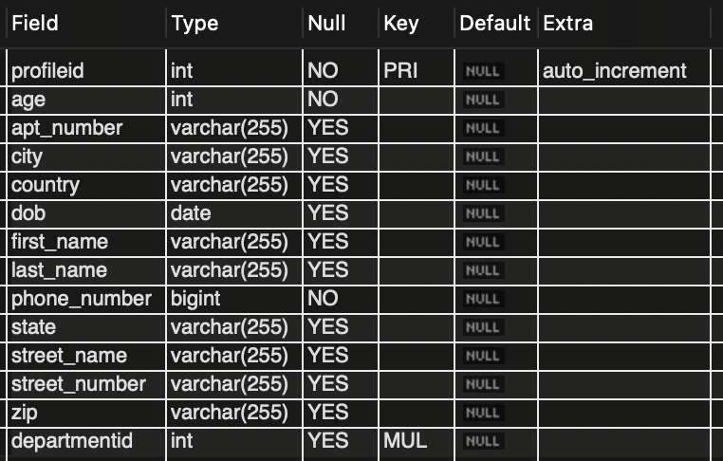
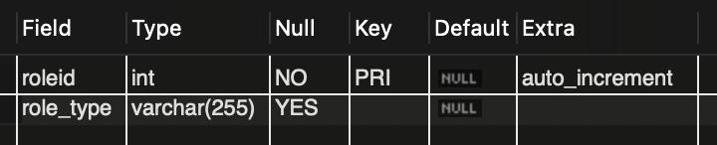
Table schemas
User Table
Profile Table
Role Table

Slide 10
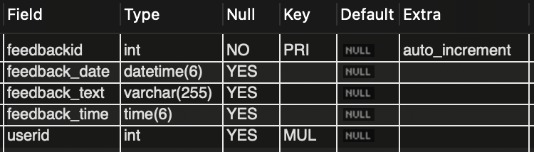
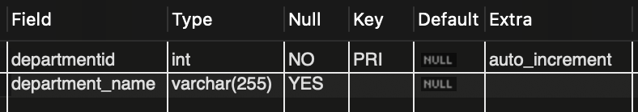
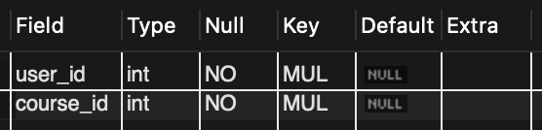
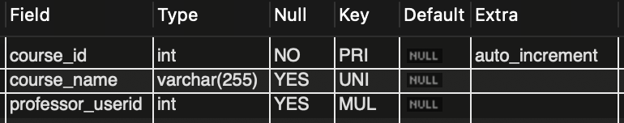
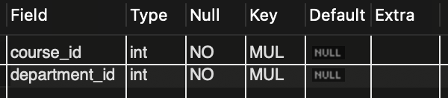
Table schemas
Feedback Table
Department Table
User Course Table
Course Table
Department Course Table

Slide 11
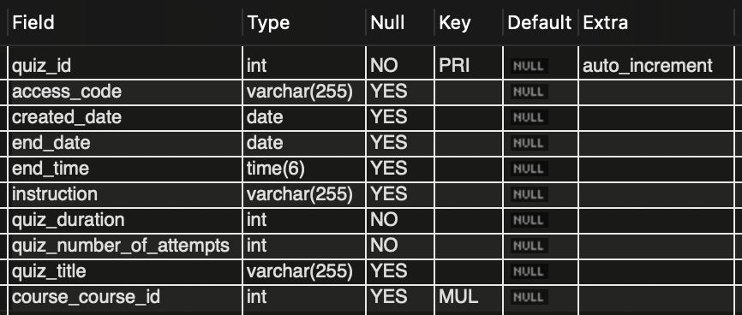
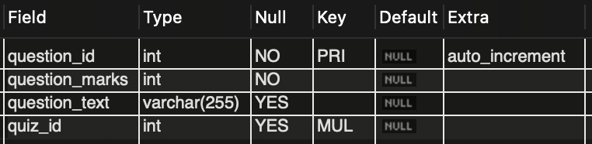
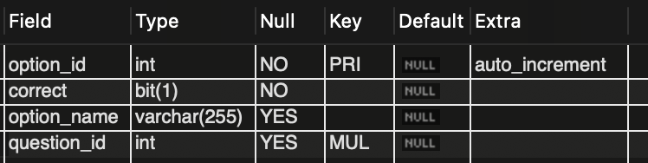
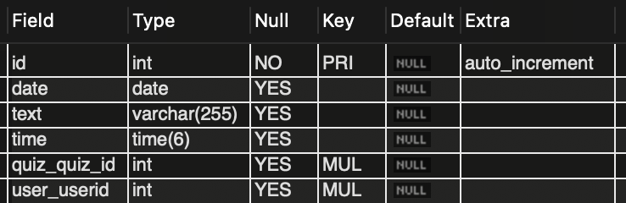
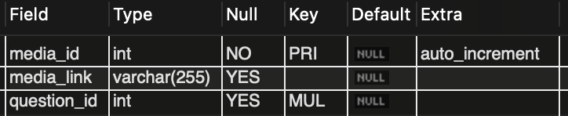
Table schemas
Quiz Table
Quiz_Feedback Table
Options Table
Question Table
Media Table

Slide 12
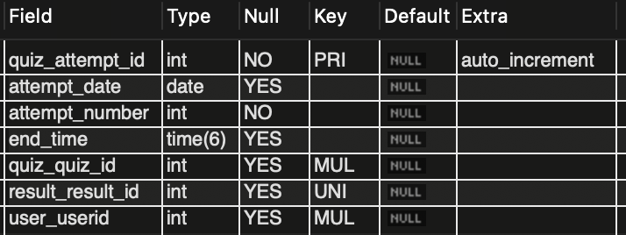
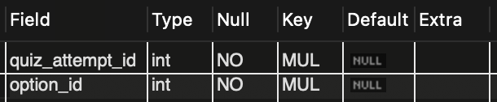
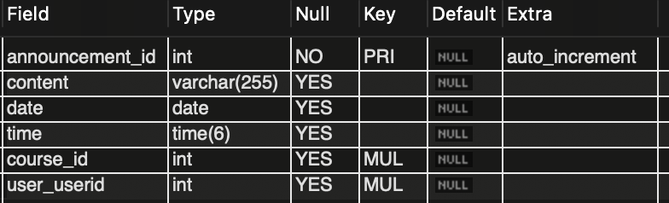
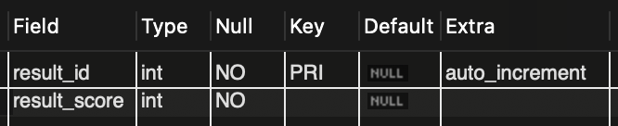
Table schemas
Attempts Table
Quiz_Attempt_Option Table
Announcement Table
Result Table

Slide 13
Challenges:
One of the major challenges faced during the project is the infinite repetition of data during cardinalities.
For example, the user table has a one-to-one relationship with the profile table. Because we used spring boot, we can have a profile object in the user object and a user object in the profile object. In that case, the data gets trapped infinitely when reading the data from the database.
To overcome this challenge we have used a spring boot annotation ‘@JSONIgnore’ which ignores one of the objects to avoid an infinite loop.
ROLES:
Kishan Kumar Zalavadia: Backend Controller, Backend Services, Backend Repositories, Backend Models/Entities, API Testing, and Version Control
Uday Bhaskar Valapadasu: Frontend Components, Frontend entities, and Frontend Services
Saptagiri Naik Bhukya: Frontend Styling using SCSS

Slide 14

Application walkthrough

Slide 15

Registration page
Users can register as different roles and select the department he/she is in.
Used is required to fill in all the details, and once registration is successful “Registration Successful” message will be shown in green color.

Slide 16
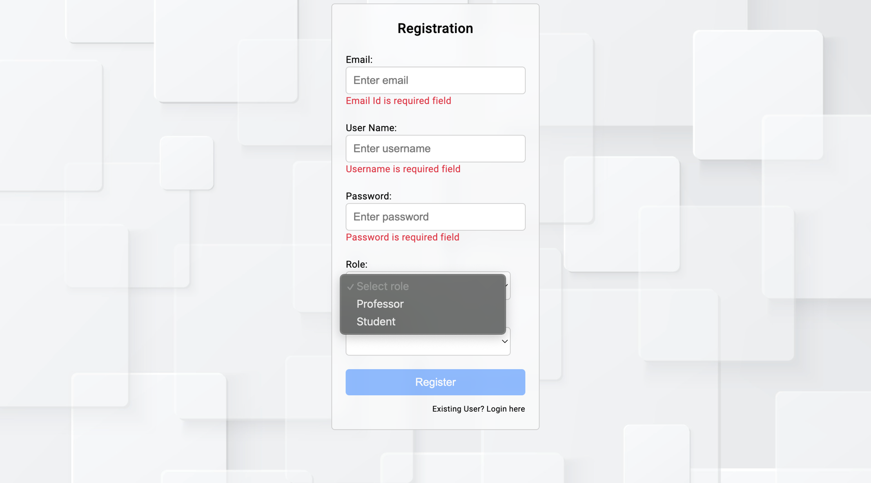

Slide 17
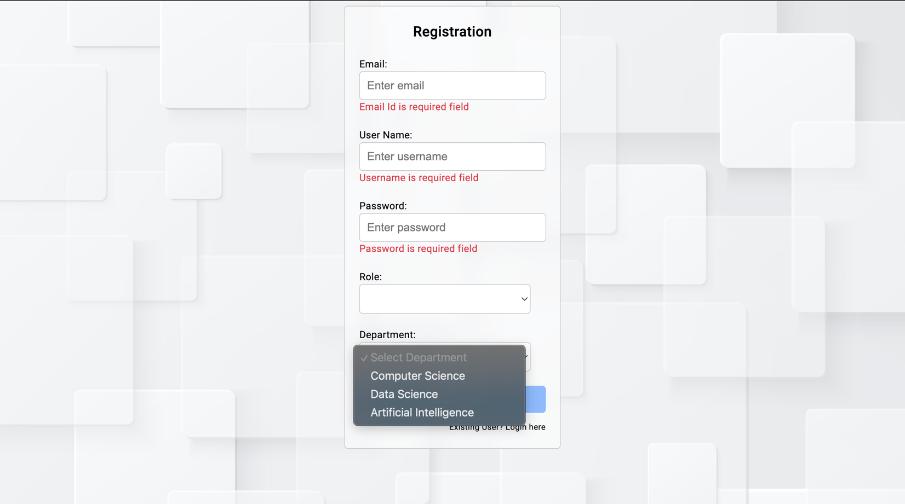

Slide 18
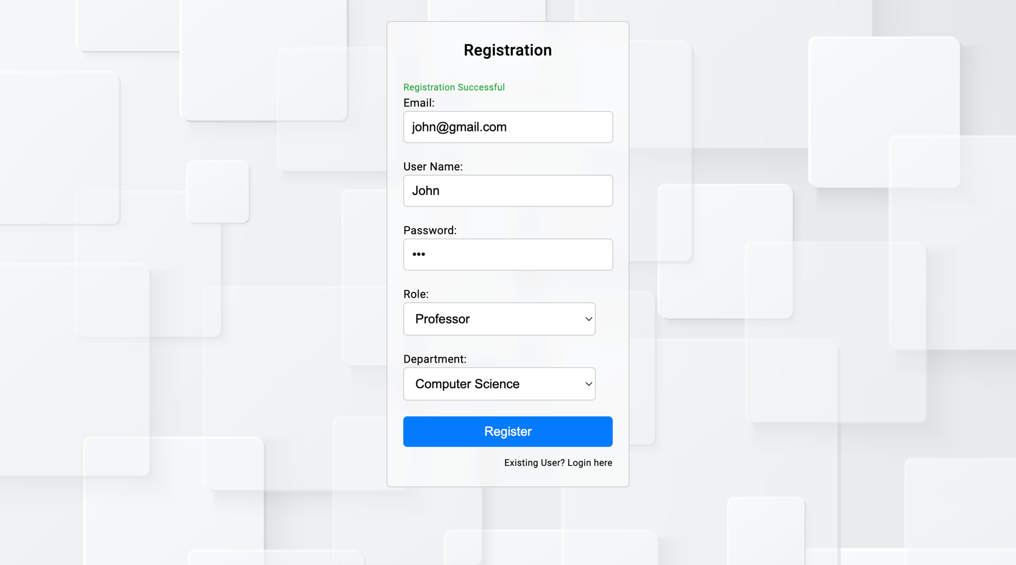

Slide 19
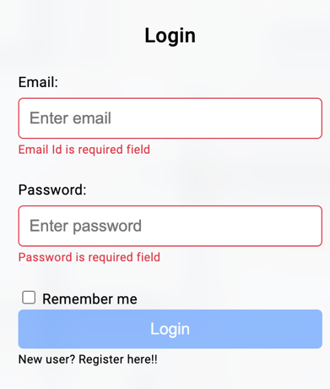
Login page
Once the user has successfully registered, he can log in using the email and password that he used while registering.

Slide 20
Home page
On the home page user can see his username in the top-left corner.

Slide 21
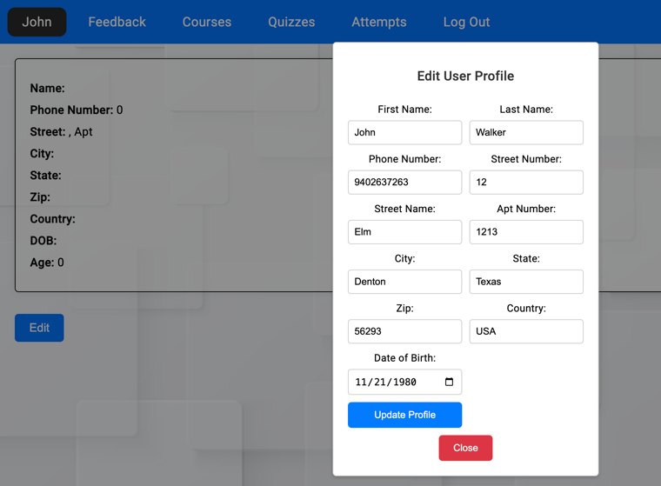
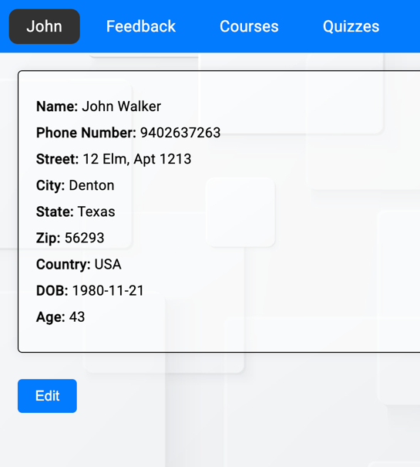
Profile page
Users can edit or update their profile at any time.

Slide 22
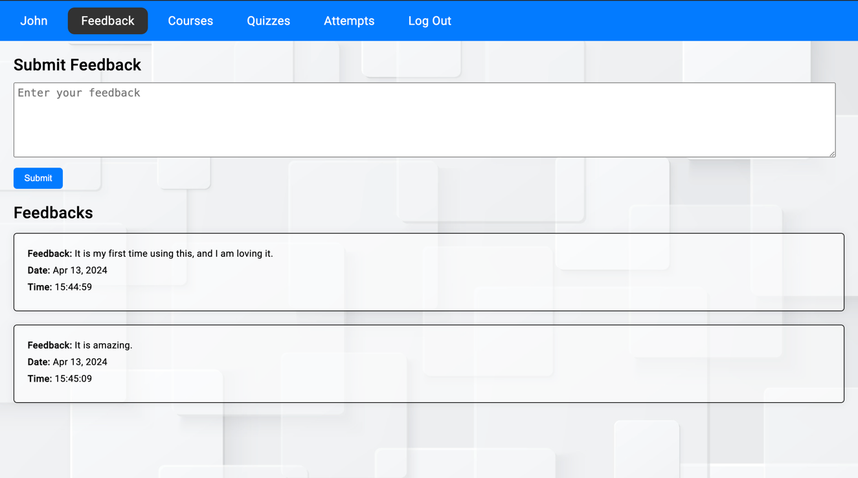
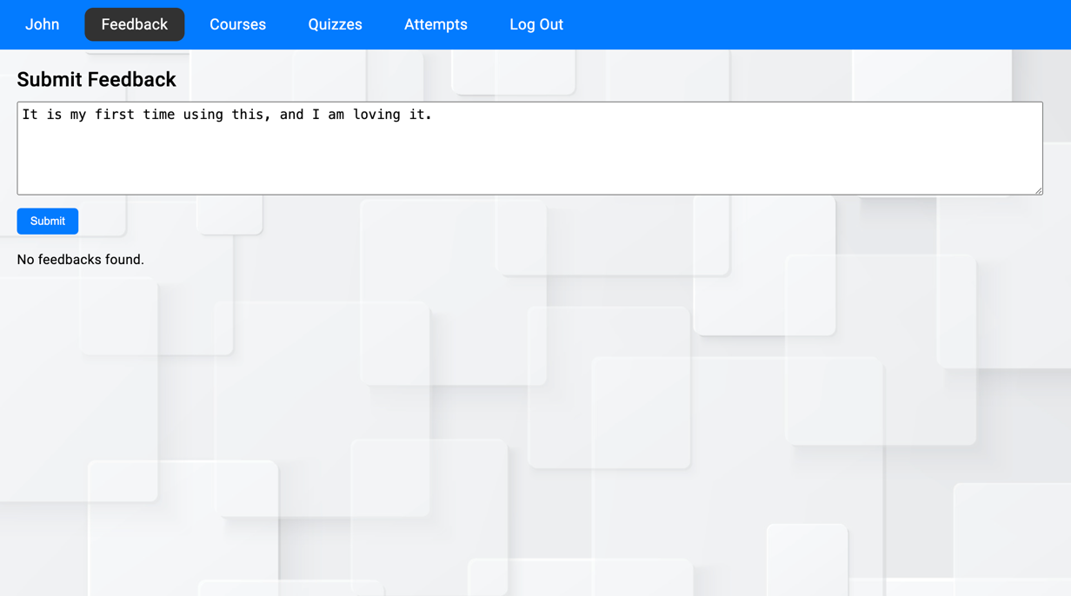
Feedback page
Users can give feedback and can see all the feedback given by them along with the date and time.

Slide 23
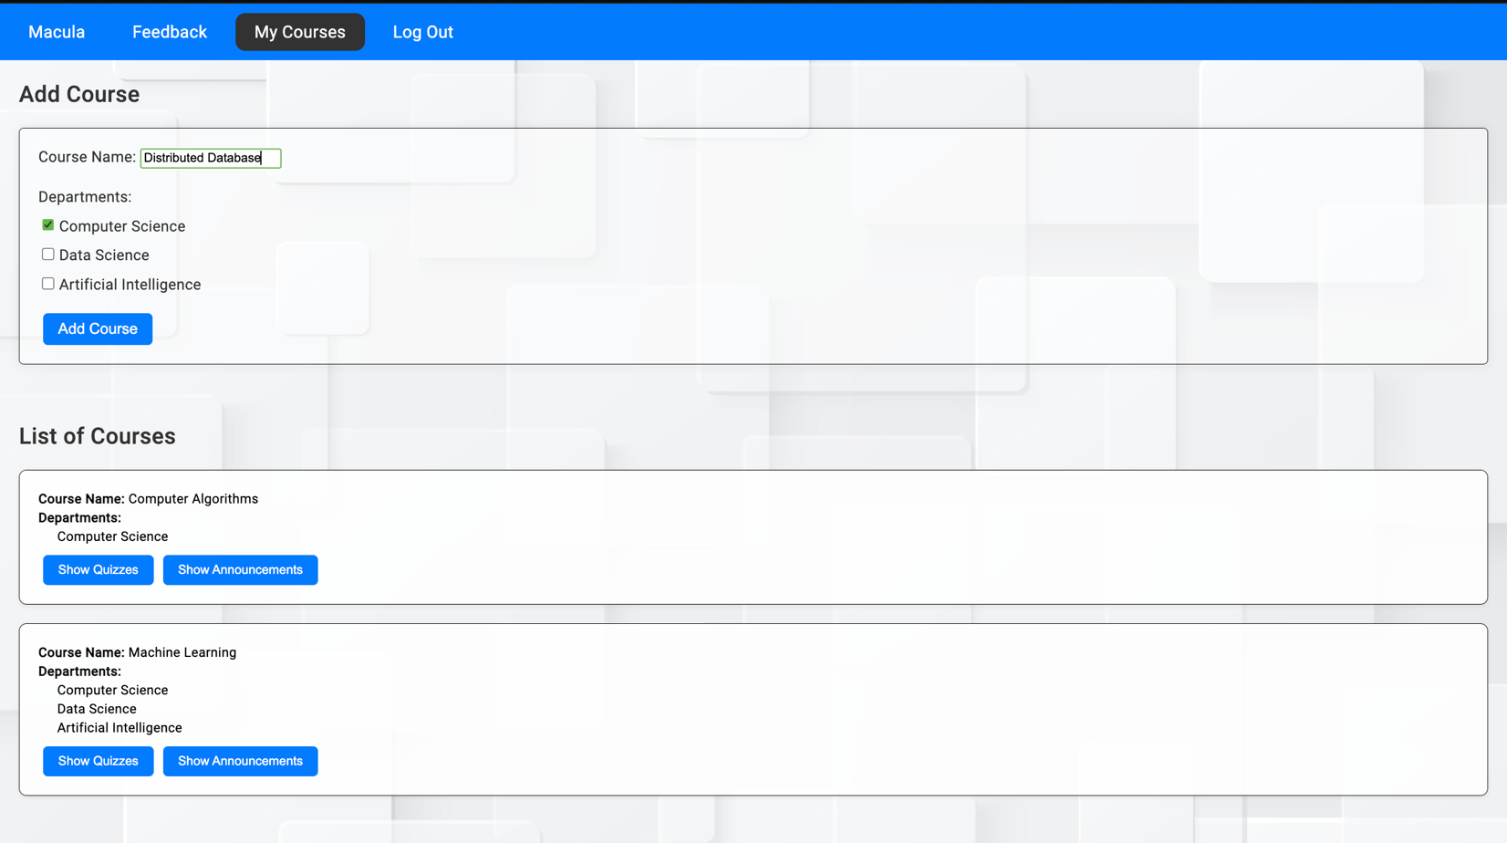
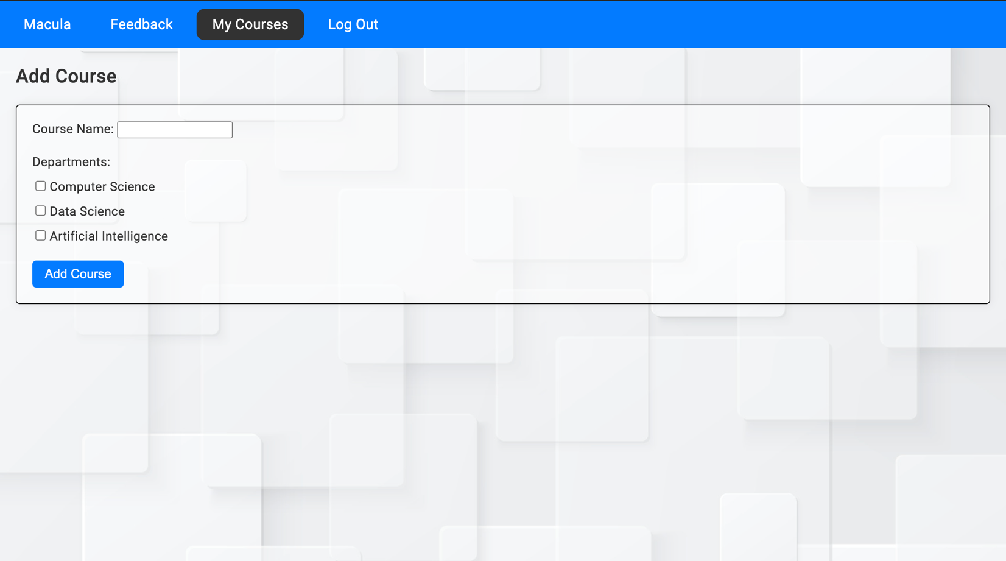
Add course (professor)
If the user is a professor, then he/she can add the course and can also choose which department students can take the course.
All the courses which the professor has created can be visible.

Slide 24
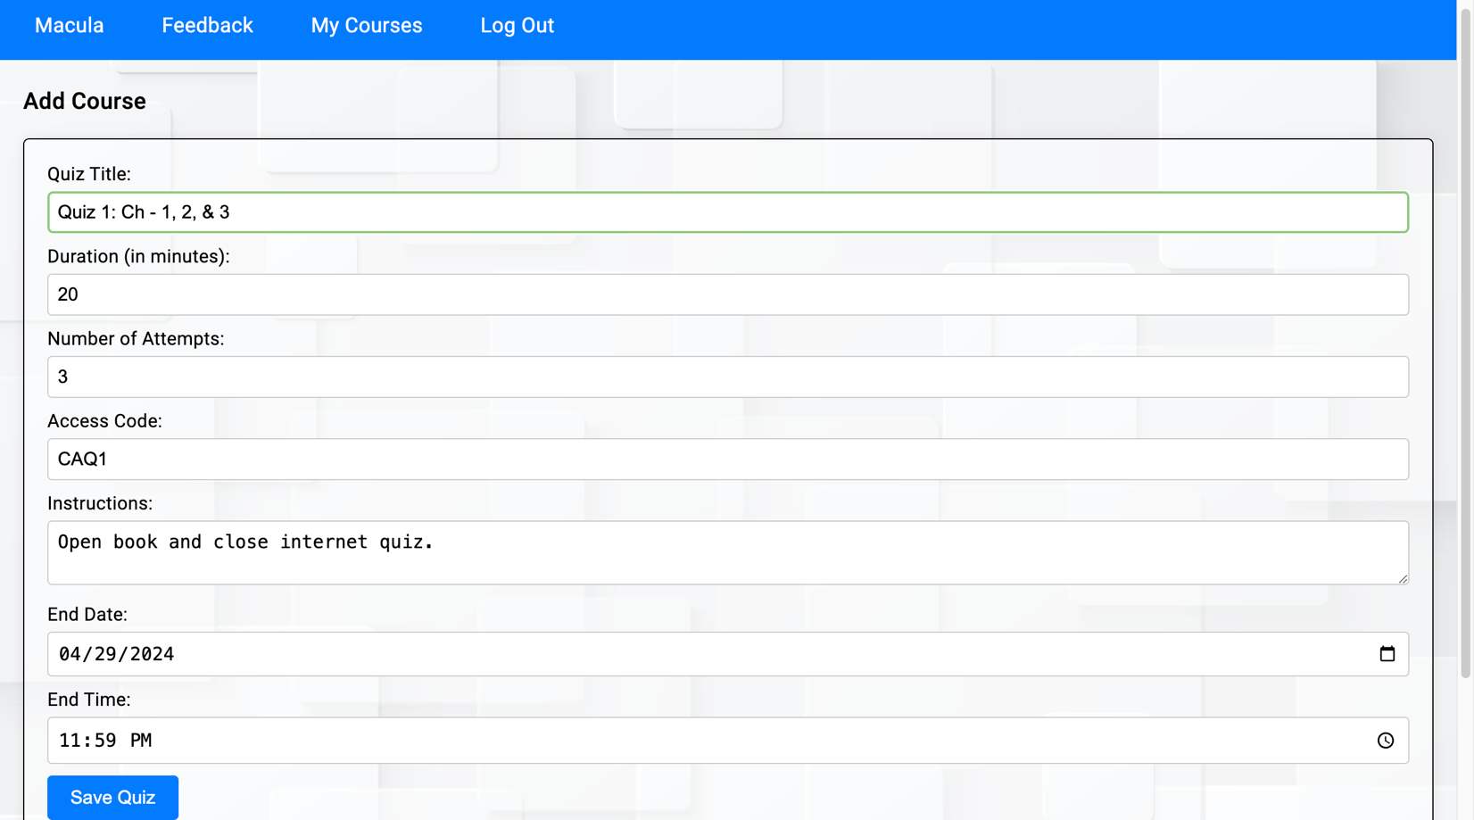
Add quizzes
The professor can create several quizzes for each course.

Slide 25
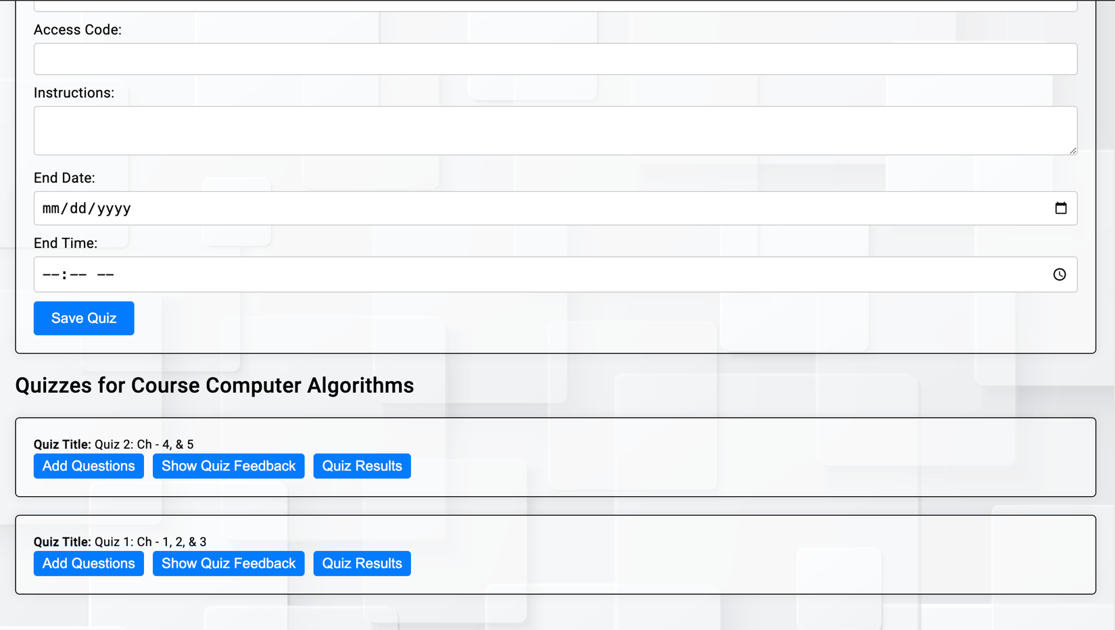
The professor can see all the quizzes that he created

Slide 26
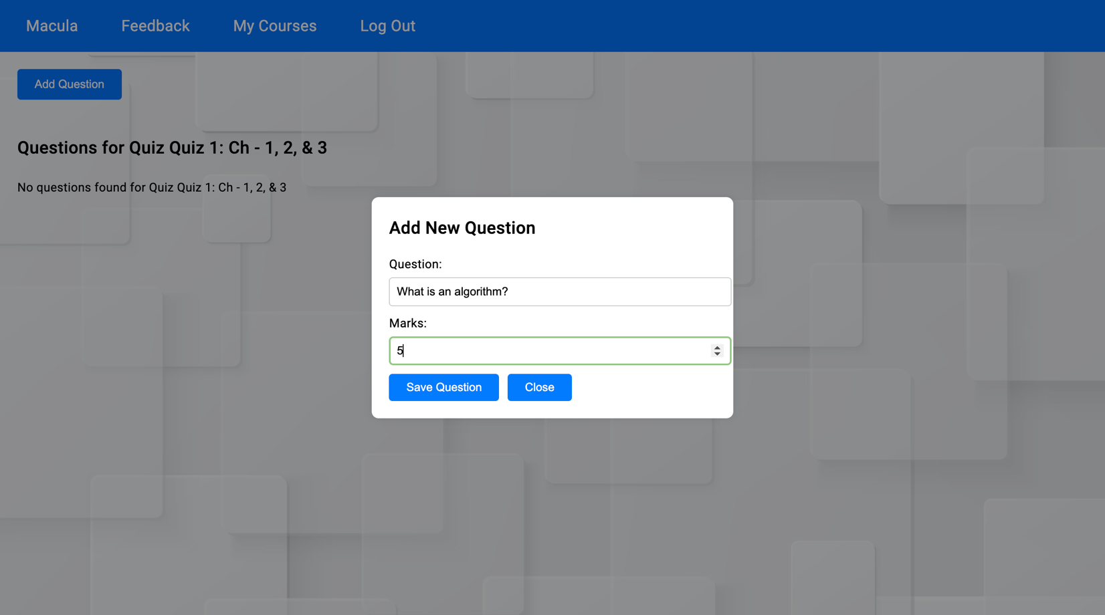
Add questions page
The professor can add questions and assign marks to each question.

Slide 27
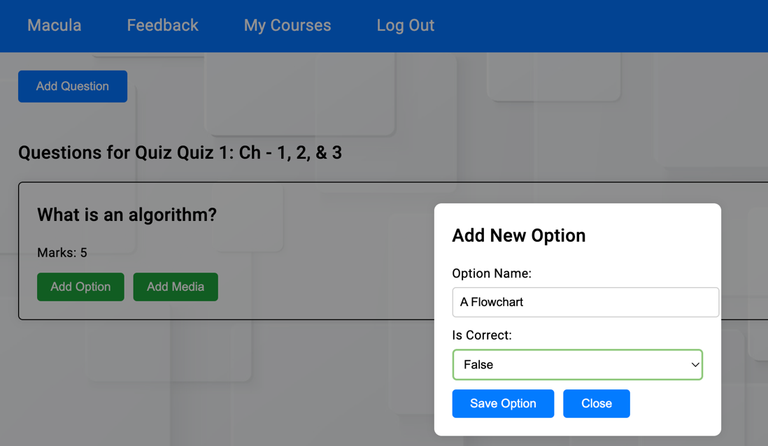
Add options
The professor can add options to the questions.
There is no limit on how many options to add for each question, that depends on the professor.
For each option, the professor can decide whether it’s the correct answer or not.

Slide 28
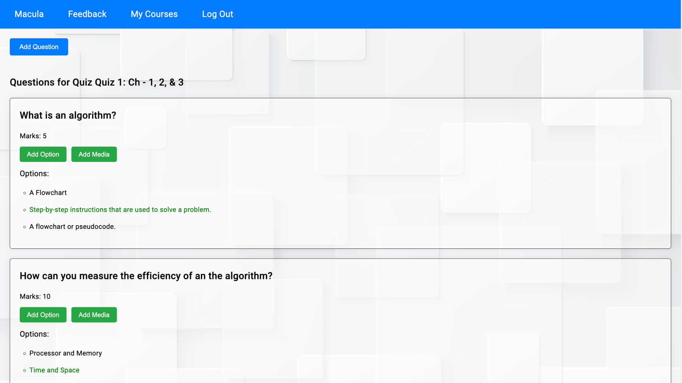
All the correct answers are visible as green only to the professor.

Slide 29
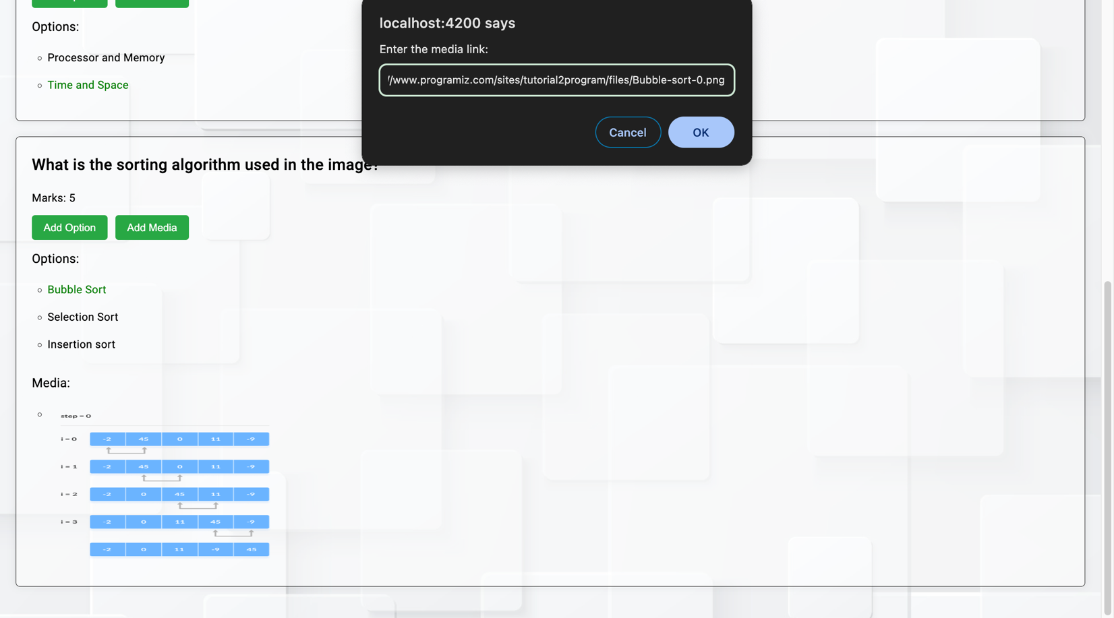
Add media
For each question, the professor can add images.
There can also be more than 1 image for a question.

Slide 30
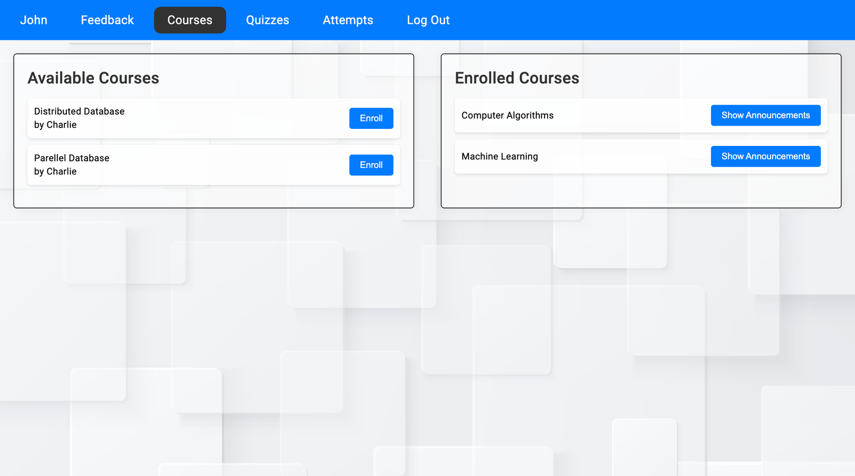
Course page
Students can see and enroll in courses.
The name of the professor is also visible who is taking that particular course.
All the enrolled courses are displayed on the right, and all courses that can be enrolled are listed on the left.

Slide 31
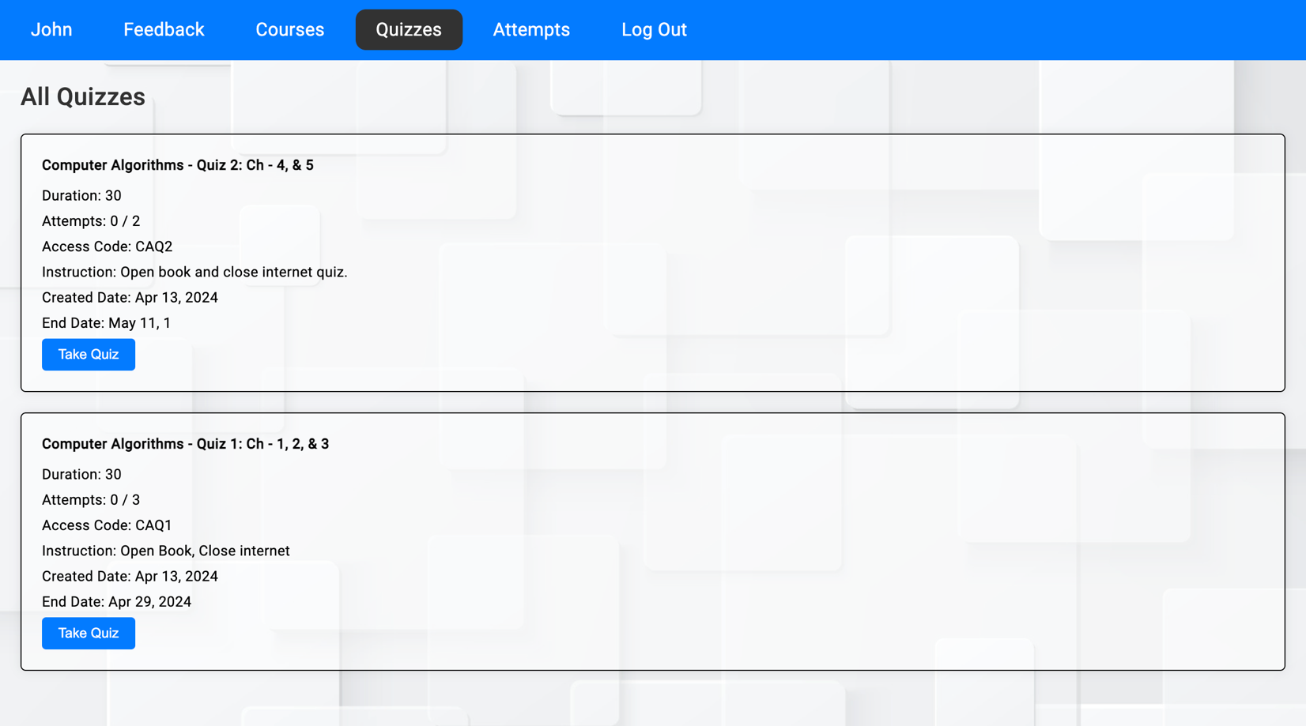
Quiz page
All the quizzes are displayed on the quiz page.
Only quizzes for the course that the user has enrolled in are visible.

Slide 32
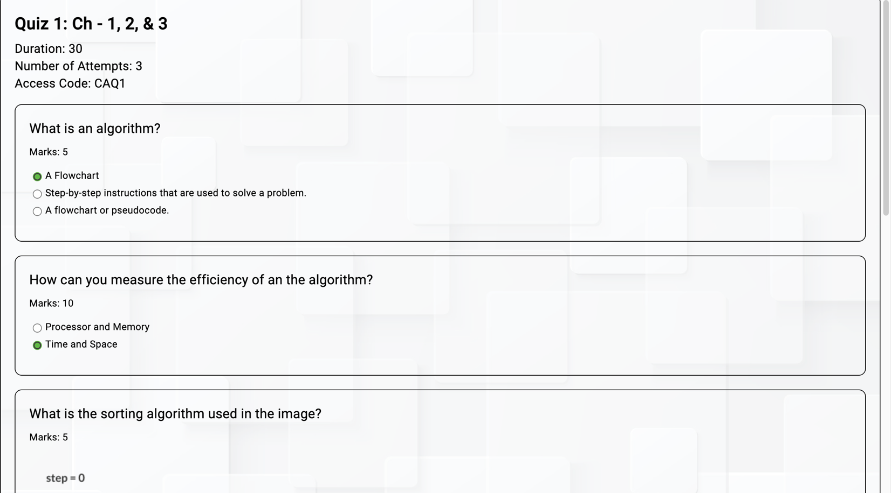
Take quiz page
Students can take quiz

Slide 33
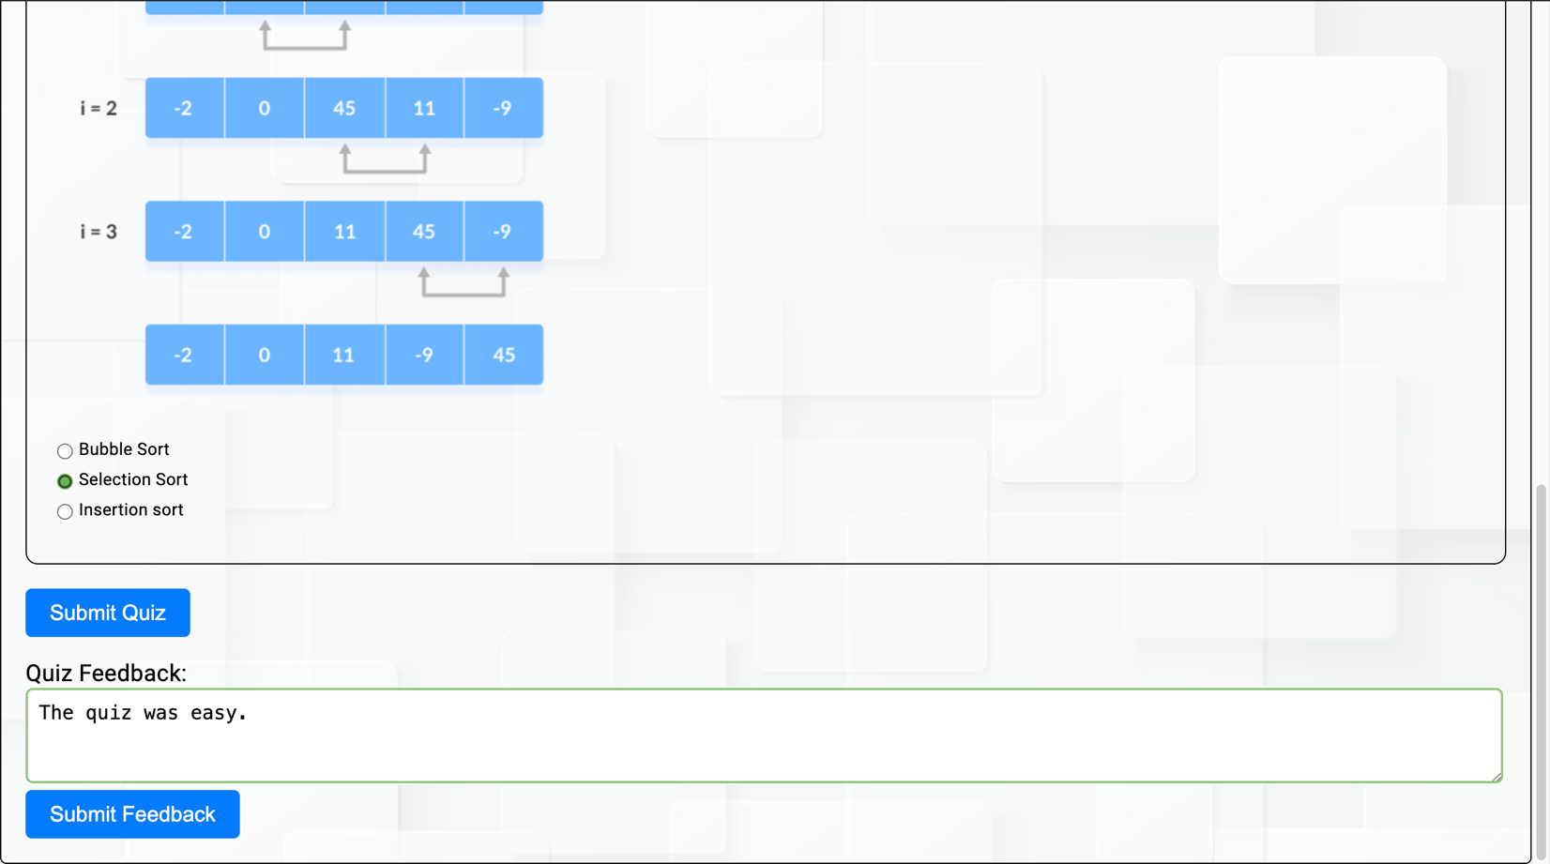
Each student can also give feedback for a particular quiz before submitting the quiz.

Slide 34
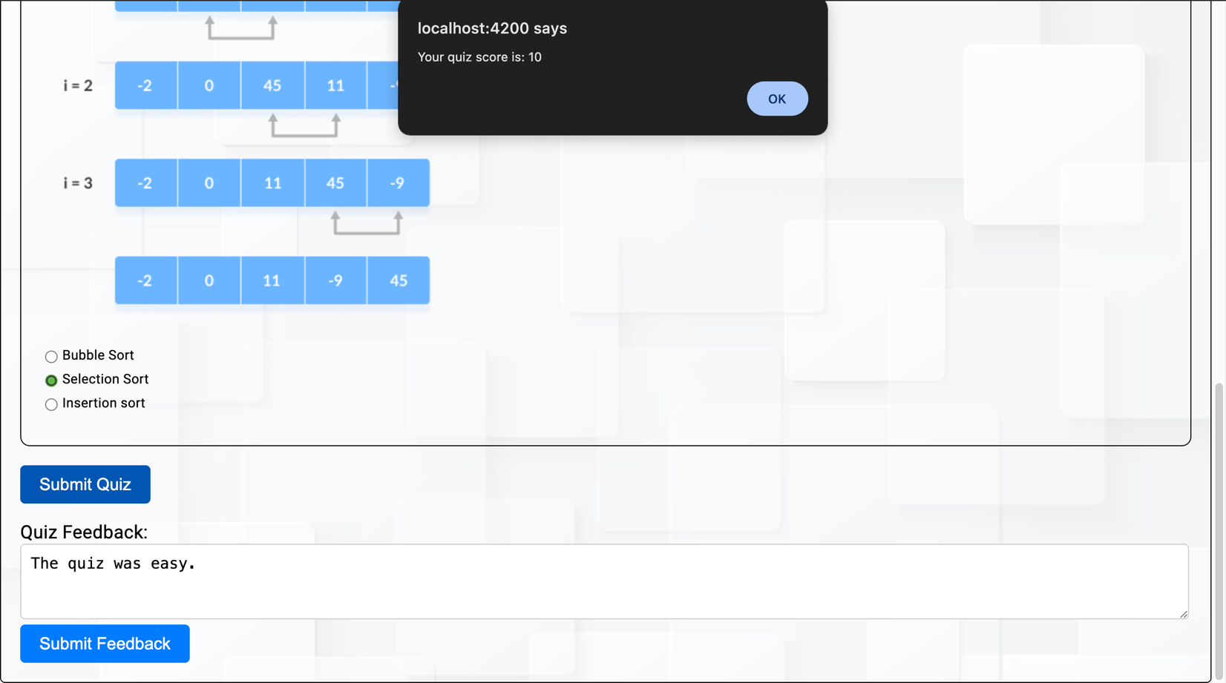
Once the student submits the quiz, he/she can see the score.

Slide 35
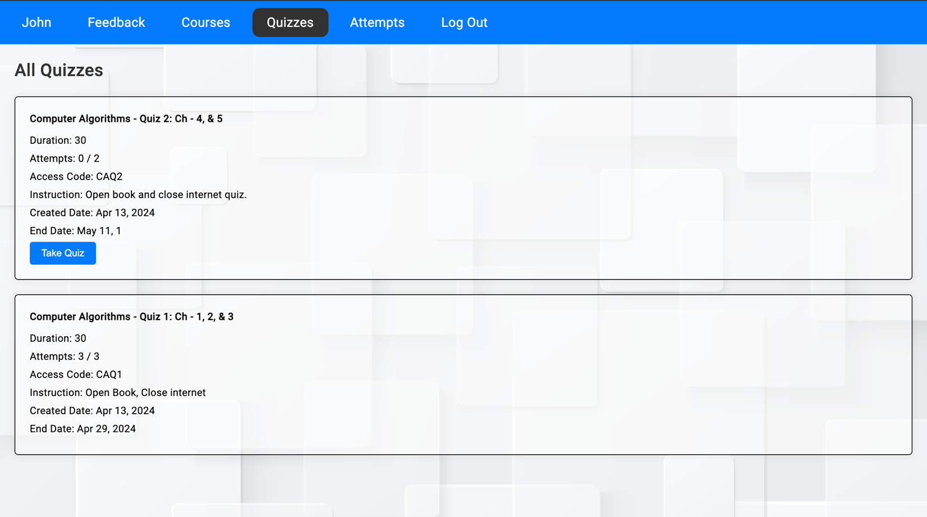
Students can also see the number of attempts remaining for the quiz.
If all the attempts are completed then the “Take Quiz” button is not visible, which means the student cannot attempt that quiz.

Slide 36
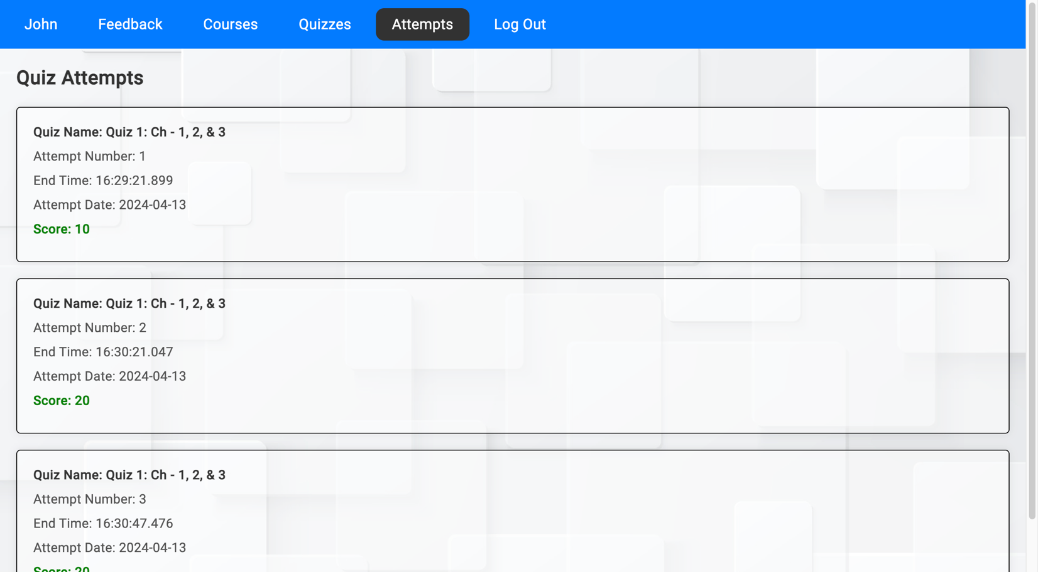
Attempt history page
All the attempts made by the student are visible on the attempts page.
Data, time, and score of that particular attempt are displayed.

Slide 37
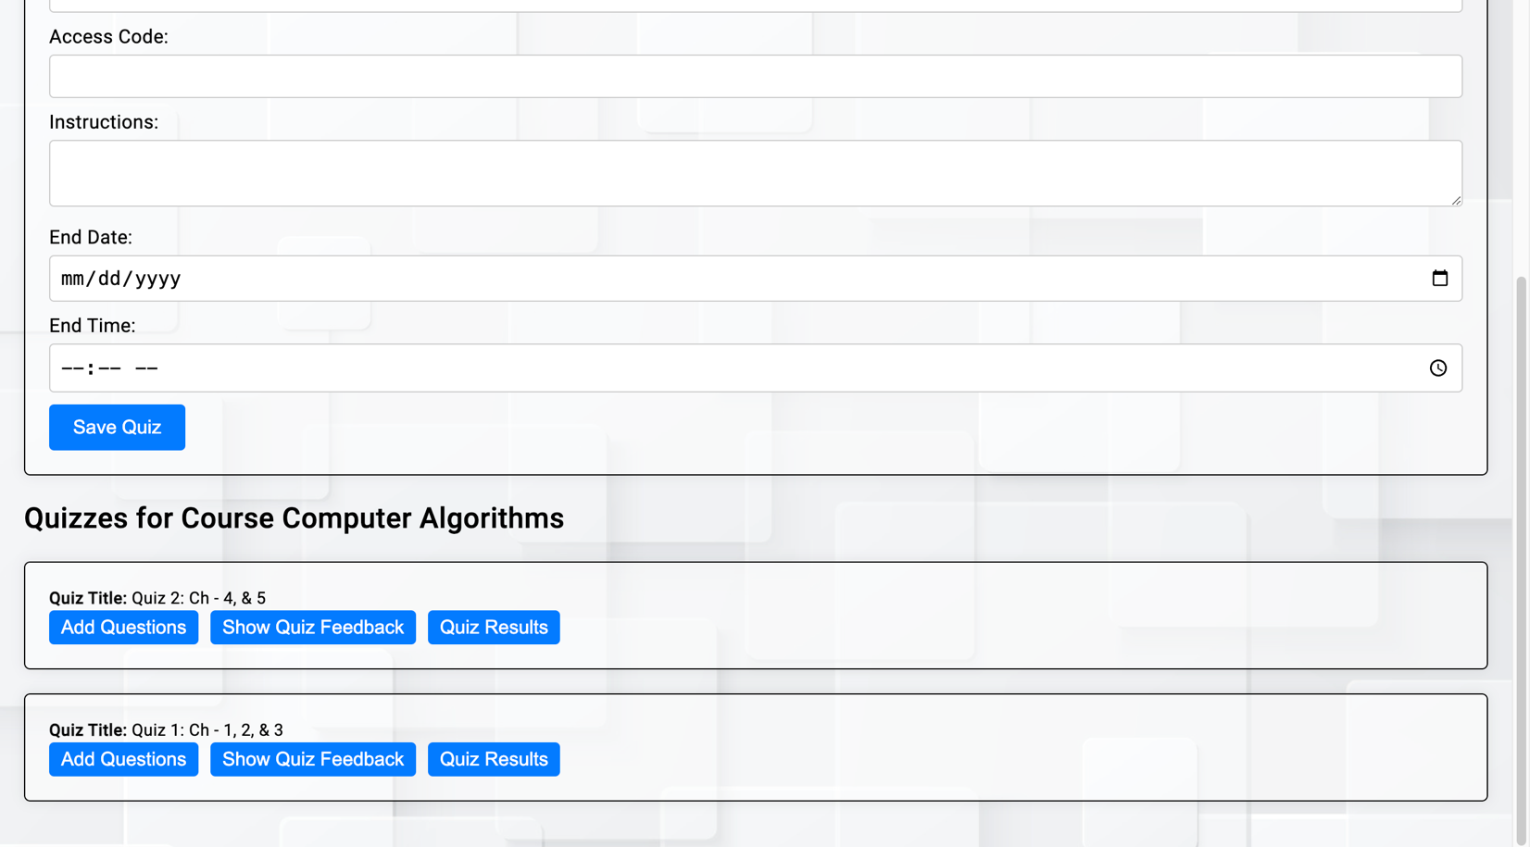
View quiz feedback
The professor can click on the “Show Quiz Feedback” button to view all the feedback given by different students as shown below.

Slide 38
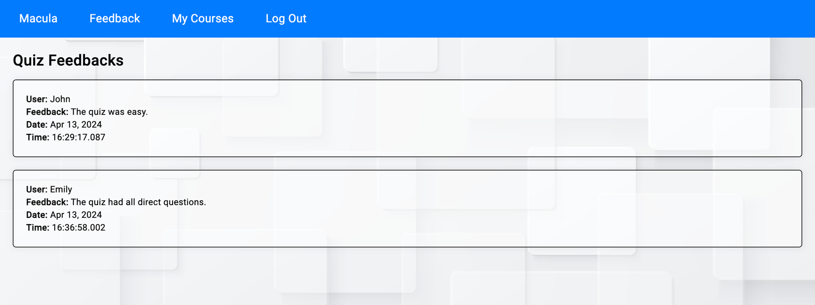
The professor can see the feedback, who has given that feedback, and also the date and time on which the feedback is given.

Slide 39
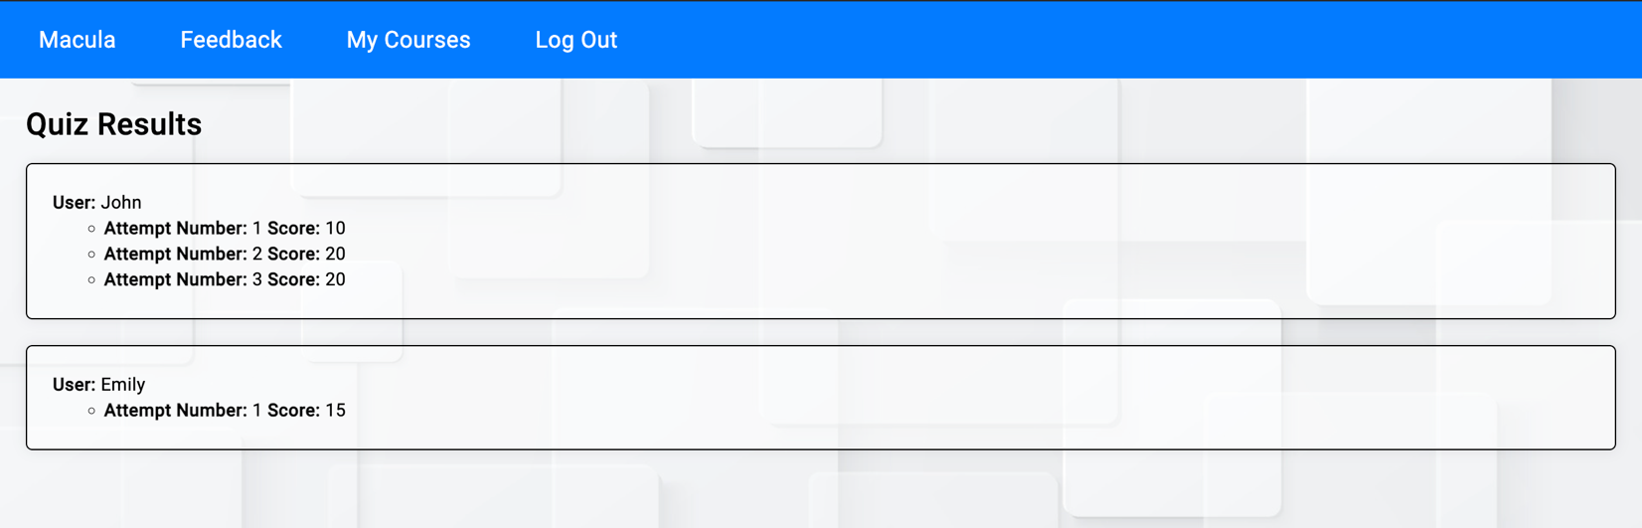
quiz results
The professor can also see all the student’s quiz results along with all the attempt scores separately.

Slide 40
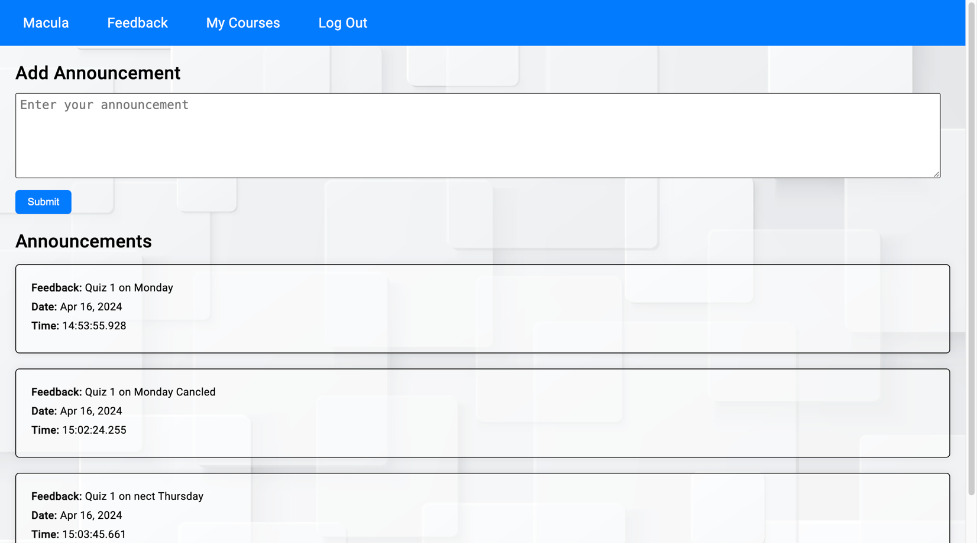
Add announcement
Each course has its announcements.
The professor can add announcements for that particular course.

Slide 41
VIEW announcement
Each course has a separate announcement.

Slide 42
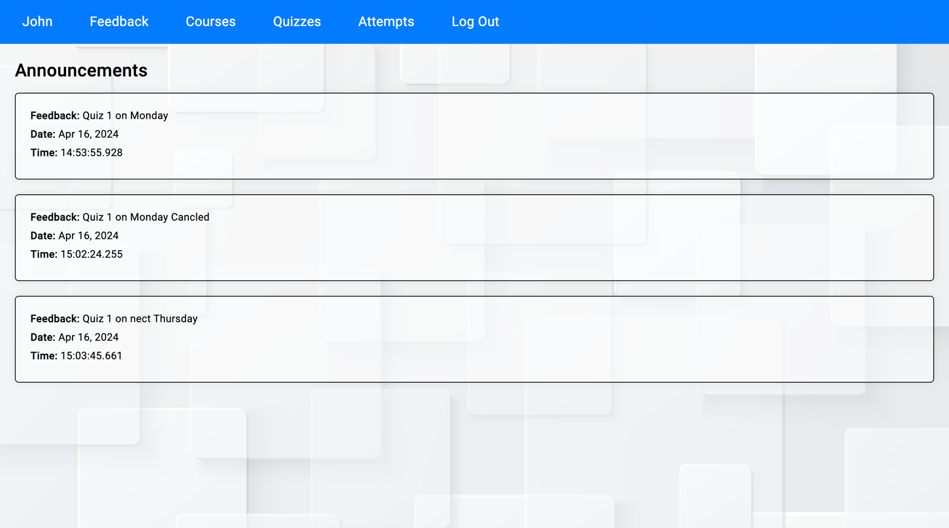
Students can see announcements for courses including data and time.

Slide 43
Conclusion
This project has achieved its objectives by providing a solution that improves the assessment process in educational institutes. This application is developed with interconnected database schema structures and the implementation of user-friendly interface interaction between professors and students.
This application allows instructors to create courses, quizzes, and announcements and students can enroll in courses, take quizzes, and view their results, and attempt history.
To maintain integrity and efficiency this system meets 1NF, 2NF, and 3NF.
One potential limitation could be scalability with a large number of users or concurrent quiz sessions.
There are many other potential applications of this database system like online testing platforms, employee training modules, or certification program tests. The complex and expandable database design makes the system indispensable in today’s digital age which offers solutions to a wide range of educational and organizational challenges.

Slide 44
Thank you

